Slide 1
HERNIAE
DR M D P PINTO
LECTURER IN SURGERY
DEPARTMENT OF SURGERY
FOM - UOK

Slide 2
DEFINITION
‘Protrusion of a viscus or a part of a viscus through an abnormal opening in the wall of its containing cavity’
Derived from Greek ‘hernios’ – to bud

Slide 3
WHAT’S THE IMPORTANCE TO YOU??
Exams
Short cases at final MBBS
A common surgical procedure in general surgery
HO - to identify, prepare for surgery and to detect post-op complications
SHO - to perform

Slide 4
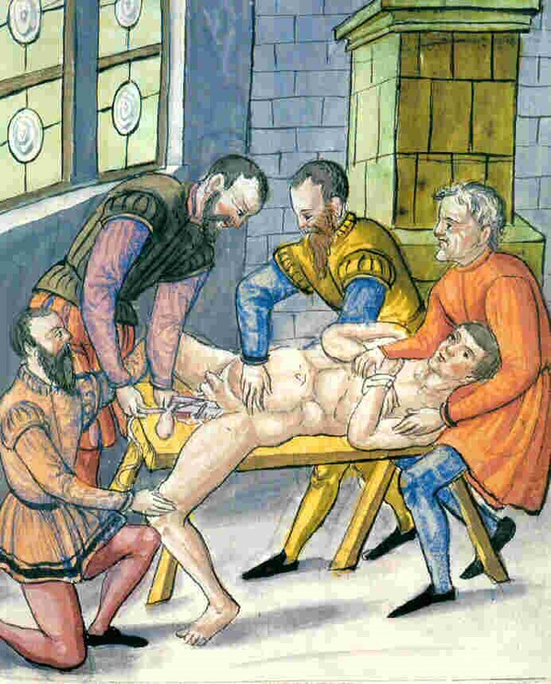
HISTORY
Swelling at coughing
Ebers papyrus (1550 BC)
Various non-operative and operative methods entertained throughout centuries

Slide 5
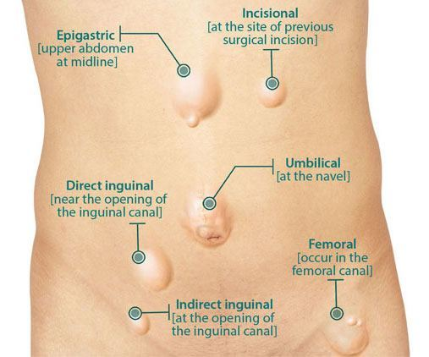
TYPES - COMMON
Inguinal
Indirect
Direct
Paraumbilical/ umbilical
Epigastric
Incisional

Slide 6
Aetiology – optimise before surgery to avoid recurrence
Causes which increase IAP – chronic straining
Chronic cough (COPD, Bronchiectasis)
Treat infection, chest physio, incentive spirometer, nebulisation
Chronic constipation (Hypothyroid, old age, colonic neoplasm)
DRE, find cause, symptomatic treatment – stool softeners
BOO symptoms (Prostatomegaly, bladder stones)
DRE, find cause
Manual labour
Smoking - acquired collagen defect
Obesity - fat deposition → separate muscle bundles, layers → weak abdominal wall

Slide 7
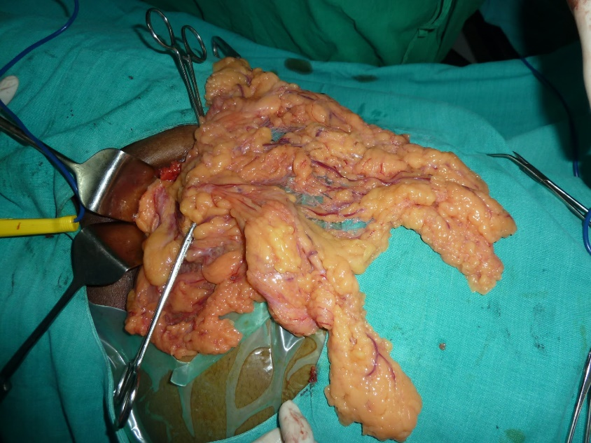
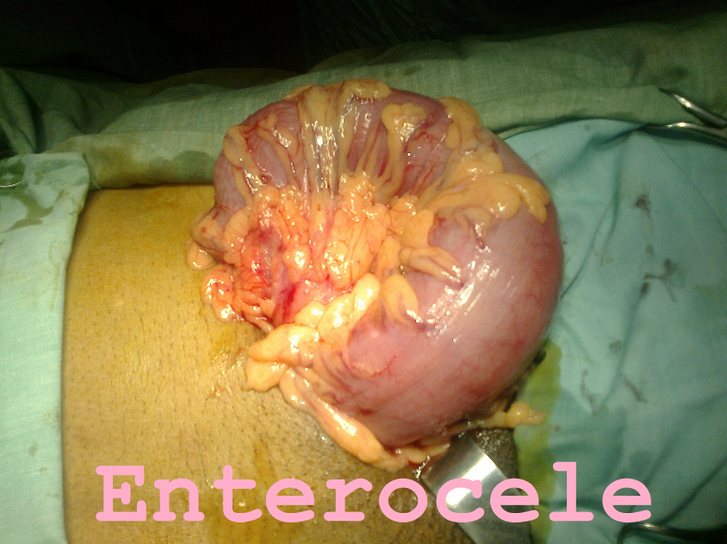
Components of a hernia
Sac
Peritoneal diverticulum
Mouth, neck, body and fundus
Small neck → susceptible to strangulate → femoral, PUH
Coverings
Acquired when sac passes through abdominal wall
Contents
Omentum (omentocele)
Intestine (enterocele)
Portion of intestine (Richter’s)
Portion of bladder (sliding hernia)
Meckel’s diverticulum (Littre’s)
Ovary, appendix (Amyand’s)

Slide 8
Classification
TYPES
REDUCIBLE | SWELLING GOES BACK ON ITS OWN OR WITH PRESSURE
IRREDUCIBLE | DOES NOT GO IN – ADHESIONS ON TO SAC
OBSTRUCTED | INTESTINAL LUMEN OBSTRUCTED > COLICKY ABDOMINAL PAIN > NO BLOCK IN BLOOD SUPPLY > NEXT IS STRANGULATION!
STRANGULATED | IMPAIRED BLOOD SUPPLY > GANGRENE > PERFORATION > PERITONISM
INCARCERATED | HERNIAL SAC BLOCKED WITH FAECES – INDENTS! HERNIAL SAC ADHERED TO SURROUNDINGS

Slide 9
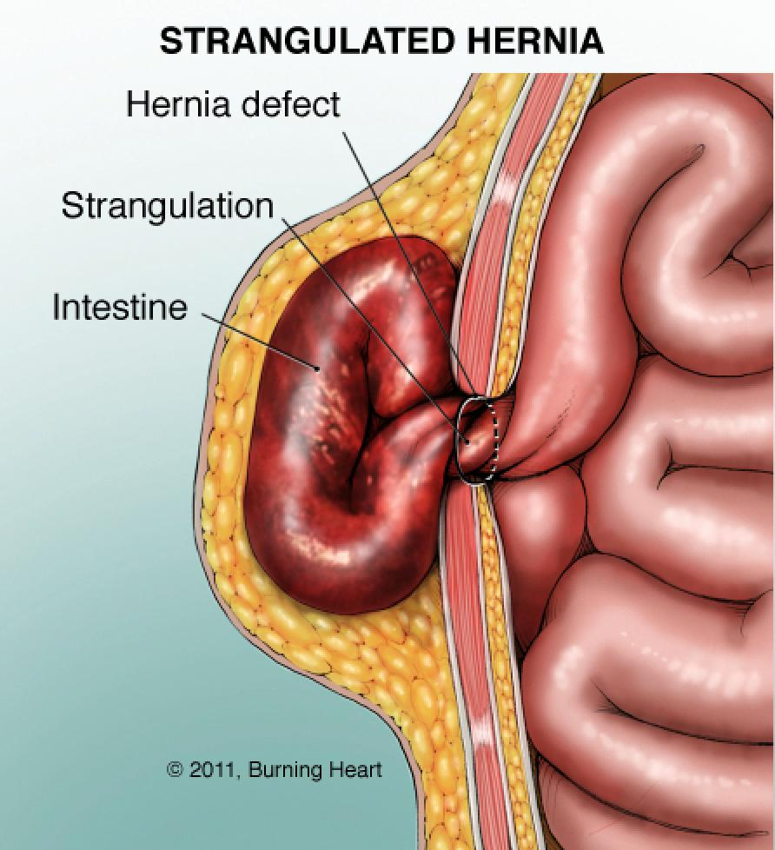
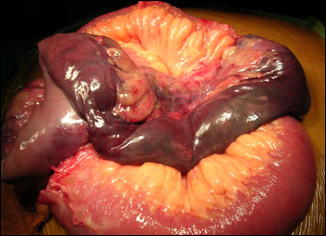
STRANGULATED HERNIA
Obstructed veins – congested, purple bowel
Obstructed arteries
blood stained fluid in sac
lost sheen on bowel
fibrinous exudate on bowel
Impending perforation
Cessation of pain – perforation !
Reduction of an obstructed hernia, which presents late maybe disastrous!

Slide 10
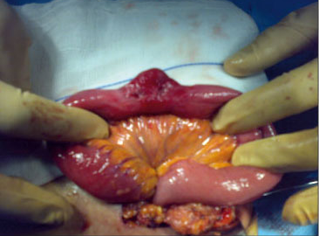
RICHTER’S HERNIA
Bowel may open as partial obstruction only!

Slide 11
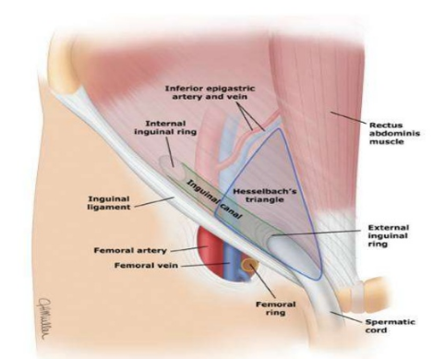
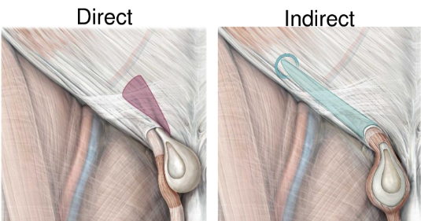
INGUINAL HERNIA

Slide 12
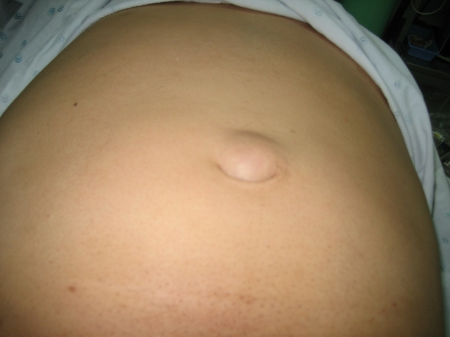
PUH
Defect in linea alba around umbilicus
High in obese women
Narrow neck!

Slide 13
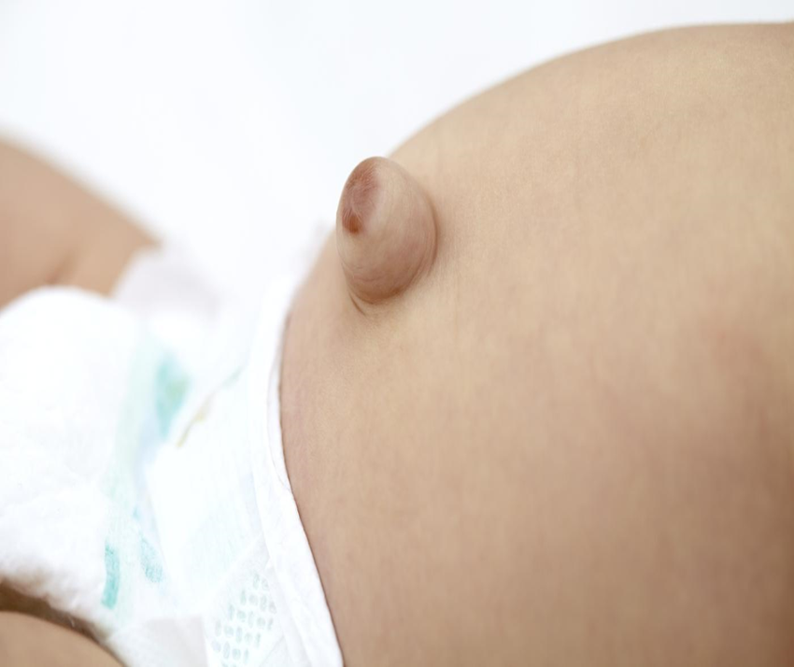
UMBILICAL HERNIA
Specially in;
Neonates – epithelialisation over a small exomphalos
Infants – defective Richet fascia
Non – operative up to 2 years
Herniorrhapy after 2 y or symptomatic
MESH repair in children ? – NO!

Slide 14
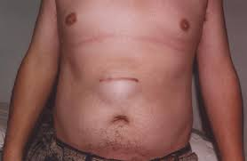
INCISIONAL HERNIA
Causes;
Increased IAP – specially during immediate post-op period
Poor technique of closure
Causes for poor wound healing
Re-operation is difficult – distorted anatomy – not a virgin plane!

Slide 15
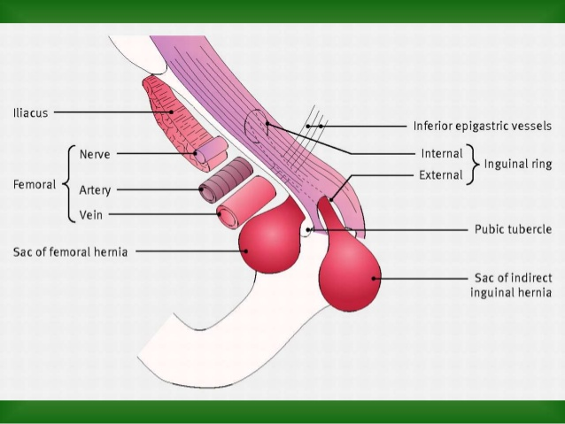
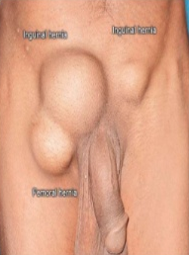
RARE HERNIA - FEMORAL
Narrow neck !

Slide 16
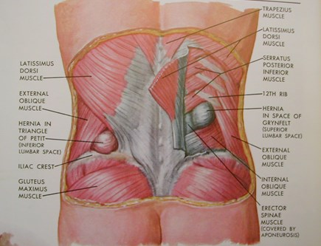
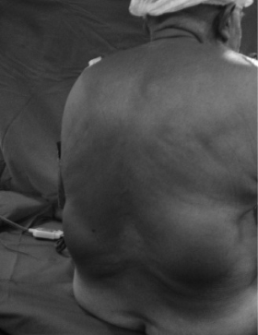
RARE HERNIA - LUMBAR

Slide 17
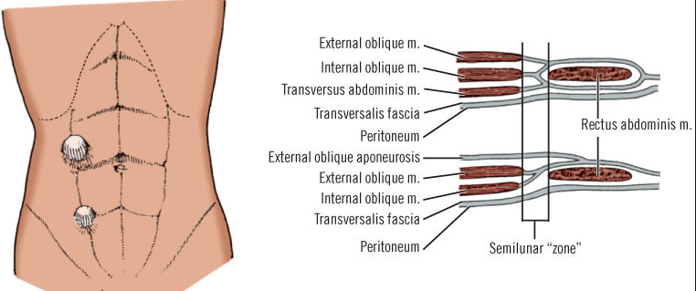
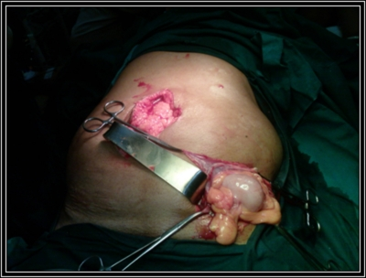
RARE HERNIA - SPIGELIAN

Slide 18
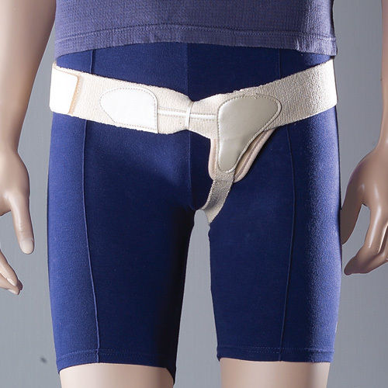
TREATMENT – NON OPERATIVE
Watchful waiting
Infantile hernia
Trusses, corsets
Non-surgical candidate
causes skin breakdown and infection

Slide 19
TREATMENT - OPERATIVE
Herniorrhaphy
Heniotomy
Mesh repair

Slide 20
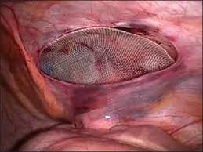
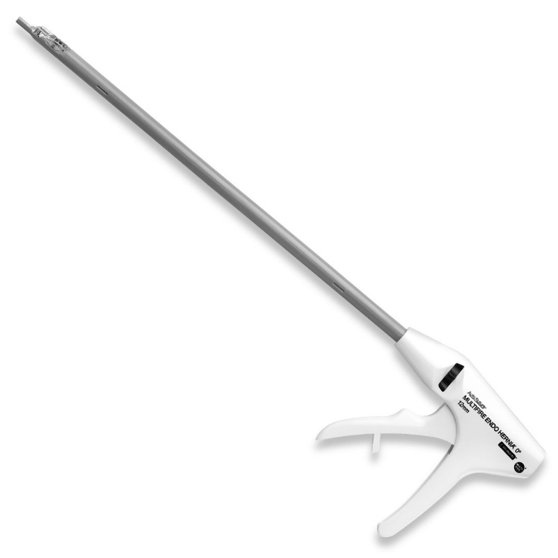
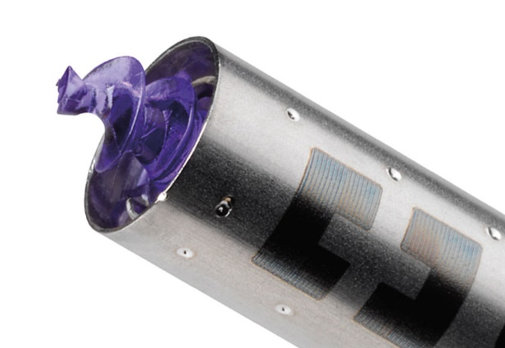
TREATMENT – LAPAROSCOPIC REPAIR
TAPP (Trans Abdominal Pre-Peritoneal) repair
TEP (Totally Extra-Peritoneal) repair

Slide 21
POST –OP INFORMATION FOR PATIENT
Avoid increase of IAP
Avoid lifting weights >5kg x 6/52
Treat a RTI
Avoid constipation
Wear an underwear – 1/52
Nutrition
Avoid smoking
Seek medical care
Swelling of surgical site, hemiscrotum – SEROMA, HAEMATOMA
Discharge from surgical site
Wound review in 7d

Slide 22
SHORT CASE
Consent
Adequate exposure
Privacy
Adequate lighting
History & Examination
To find aetiology
To classify
Presentation
Discussion

Slide 23
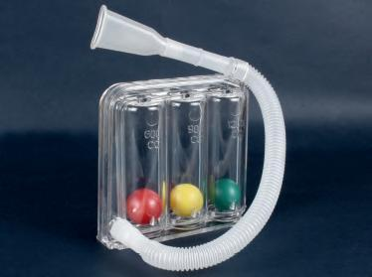
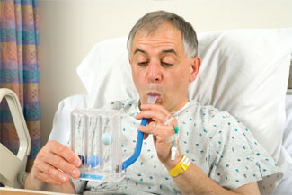
QUESTIONS ?
Incentive spirometer
Keeps alveoli open
Decrease fluid accumulation and atelectasis following surgery
Inhale deeply → hold breath for 5s → exhale → 10/hour
To be taught pre-operatively

